Slide 1

BNPL Credit Risk Analysis

Slide 2
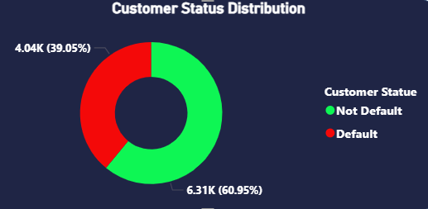
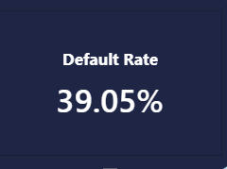
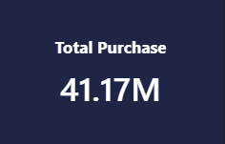
What is the overall portfolio health in terms of repayment and default?
Insight: The default rate sits at a critical high of 39.05% (4.04K defaulted customers), with only 11.78% paying on time. Furthermore, 88.22% of customers experience delayed repayments, representing 36.38M out of 41.17M total purchase volume.
Recommendation: Immediately tighten credit approval standards and revise collection/reminder workflows prior to due dates to convert delayed payments into on-time settlements.

Slide 3
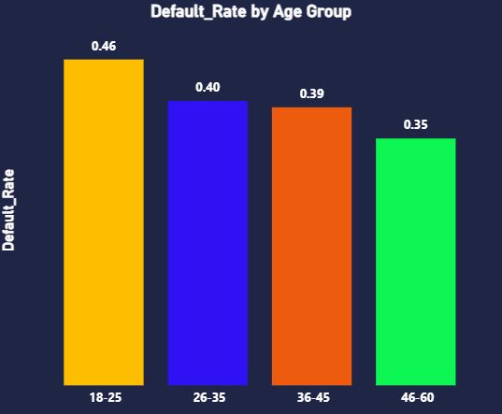
How does customer age correlate with default risk?
Insight: Default rates decline steadily as age increases: the 18–25 age group has the highest default rate (46%) , whereas the 46–60 age group exhibits the lowest (35%) .
Recommendation: Implement stricter credit limits and mandatory identity/income verification steps for younger applicants (18–25), while raising credit lines for mature demographics (46–60).

Slide 4
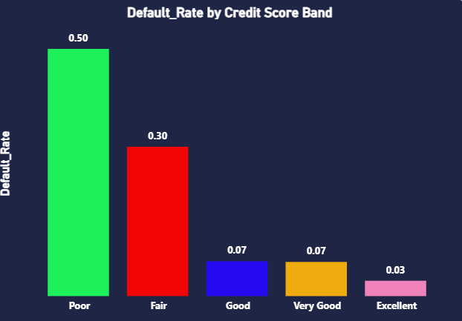
Which credit score bands present the highest operational risk?
Insight: Customers in the Poor credit score band drive a massive 50% default rate (0.50), compared to just 3% (0.03) in the Excellent band.
Recommendation: Restrict or require partial down payments for customers in the "Poor" band to mitigate upfront credit exposure.

Slide 5
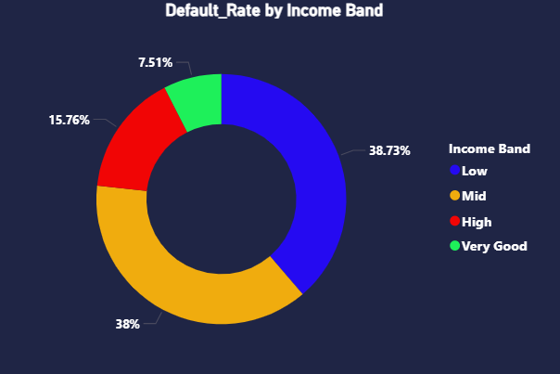
How does income level affect default behavior?
Insight: Low-income and Mid-income customers account for the majority of defaults, holding 38.73% and 38.00% share of total defaults respectively, compared to 7.51% for the Very Good income band.
Recommendation: Introduce dynamic financing terms—such as shorter installment windows and lower spend caps—specifically catered to low and middle-income segments.

Slide 6
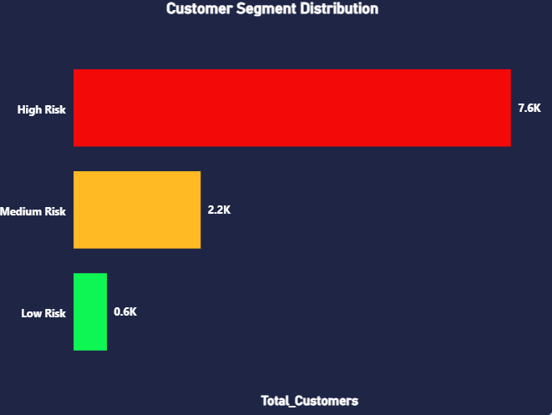
How is the customer base distributed across risk tiers?
Insight: Over 7.6K out of 10K customers (76%) fall into the High Risk segment, yielding an average risk score of 198.53 and an average credit score of 448.18.
Recommendation: Re-evaluate current underwriting algorithms; the platform is heavily over-indexed on high-risk users, calling for a rebalancing toward medium- and low-risk profiles.

Slide 7
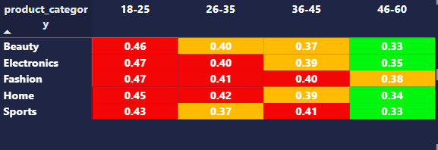
Which product categories drive the highest revenue vs. default exposure?
Insight: Fashion (8.61M) and Electronics (8.42M) generate the highest purchase volume. Across all product categories, default rates peak in the 18–25 age group (ranging from 43% to 47% default rate).
Recommendation: Partner with high-volume merchants (Fashion & Electronics) to co-subsidize risk protection or apply category-based lending caps for younger buyers.

Slide 8
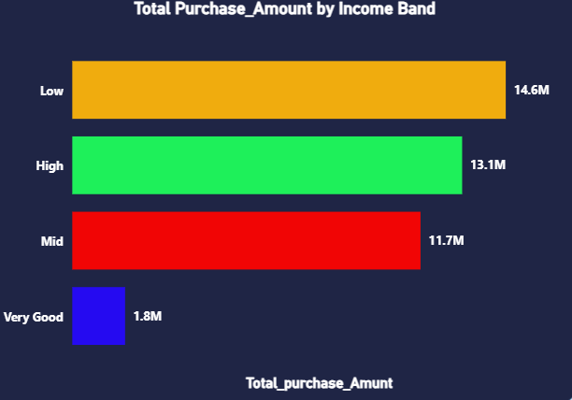
How are purchases distributed across income bands?
Insight: Low-income customers account for the largest share of purchase volume at 14.6M, followed by High-income at 13.1M and Mid-income at 11.7M.
Recommendation: Focus marketing efforts on acquiring high-income users who spend heavily (13.1M) but maintain significantly lower default rates (15.76%).

Slide 9
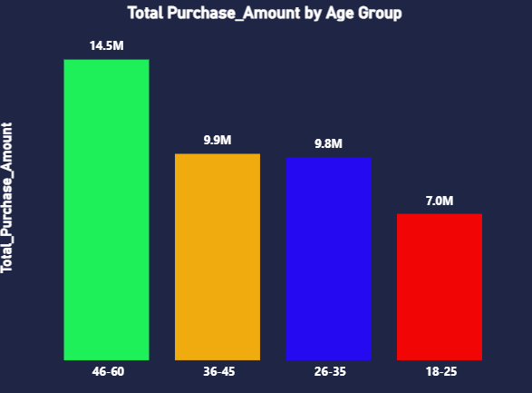
Which demographic purchasing segment brings the highest total revenue?
Insight: The 46–60 age group generates the highest purchase amount (14.5M), despite representing only 33.63% (3.48K) of the customer base.
Recommendation: Create tailored loyalty and cross-selling campaigns targeted at the 46–60 age bracket, as they offer the highest lifetime value and lowest risk.

Slide 10
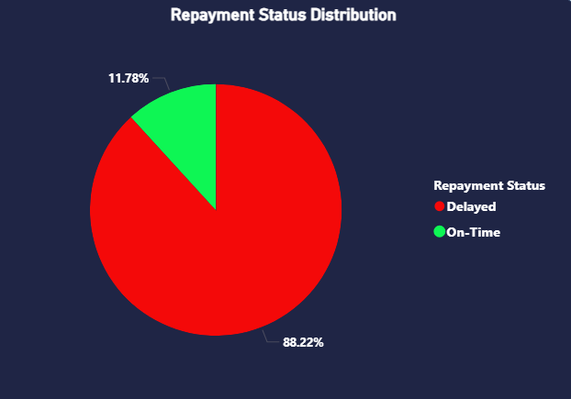
Is the current collection and recovery model performing effectively?
Insight: Only 4.79M out of 41.17M total purchase amounts are collected on time, leaving 36.38M exposed to repayment delays and potential default.
Recommendation: Restructure the repayment schedule by offering automated auto-debit discounts, flexible restructuring options, and early payment incentives.

Slide 11
Key Insights
1) Severe Risk Concentration: The BNPL portfolio faces critical credit risk, with a 39.05% default rate, 73.2% high-risk customers, and 88.22% delayed repayments.
2) Demographic Vulnerability: Younger customers (18–25) and lower credit bands (Poor score) are the main drivers of default (46%–50% default rate) .
3) High-Value Anchors: The 46–60 age group delivers the highest revenue (14.5M) with the lowest risk profile (35% default rate).

Slide 12
Strategic Recommendations
1) Tighten Underwriting: Adjust automated credit scoring models to automatically reject or require higher down payments for "Poor" credit band applicants.
2) Shift Customer Acquisition: Redirect marketing budgets toward mature, high-income customer segments (ages 36–60) to improve overall portfolio quality.
3) Automate Collections & Early Pay Incentives: Implement auto-debit rules and small discount incentives to reduce the 88.22% delayed repayment rate.

Slide 13


